Slide 1
Cryptococcosis: Clinical presentation
David W. Denning
The University of Manchester

Slide 2
Intended Learning Outcomes
To be aware of the different clinical manifestations and presentation of cryptococcal disease

Slide 3
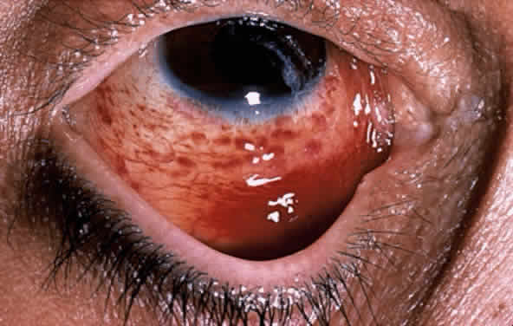
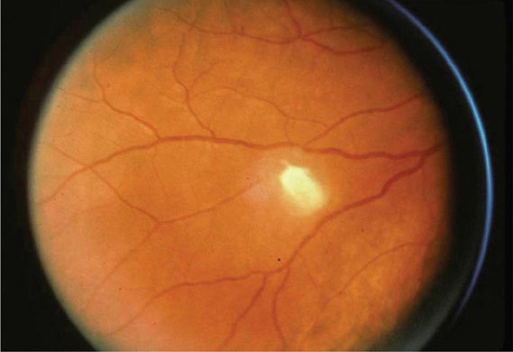
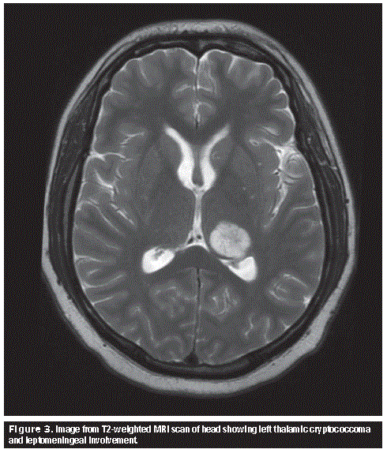
Clinical manifestation
Cryptococcus has a high predilection for the lungs and brain
Skin lesions are uncommon (more frequent in histoplasmosis)
Most patients presents with full blown CNS infection
Other less frequently involved sites includes:
Skin, prostate, eyes, bones/joints etc
Disseminated cases are often seen in severely immunocompromised individuals.

Slide 4
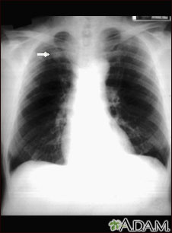
Pulmonary cryptococcosis
The lung is the portal entry for Cryptococcus
Most common clinical manifestation after CNS
Majority of patients are asymptomatic
A few patients present with a simple nodule on chest radiographs
Others develop life-threatening pneumonias or ARDS
10-55% of AIDS patients present with concomitant pulmonary and CNS disease.
Serum CrAg is usually negative in pulmonary cryptococcosis without dissemination

Slide 5
Pulmonary cryptococcosis: Clinical manifestations
Immunocompetent
Immunocompromised
Cough ~50%
Mucoid sputum <50%
Pleuritic chest pain ~50%
Less common features
Low-grade fever
Dyspnoea
Weight loss
Malaise
Fever ~80%
Cough ~60%
Dyspnoea ~50%
Headache <50%
Weight loss <50%
Less commonly
Pleuritic pain
Haemoptysis
Rales or pleural rub
Acute respiratory distress syndrome (ARDS)
Notes:
++++ …over 80%
+++ over 60%
++ --50%
+ less than 50%

Slide 6
Pulmonary Cryptococcosis
Radiological findings include:
Granulomas: 2-7 cm
Single or multiple nodules
Patchy pneumonitis
Pulmonary infiltrates
Cavitation
Pleural effusions
Mediastinal lymphadenopathy
Miliary disease similar to that of TB

Slide 7
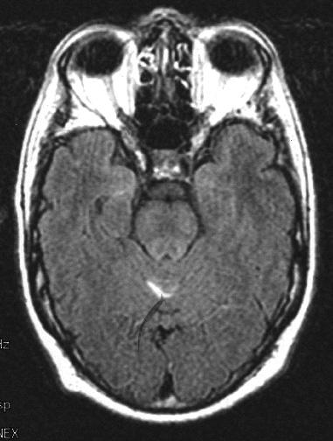
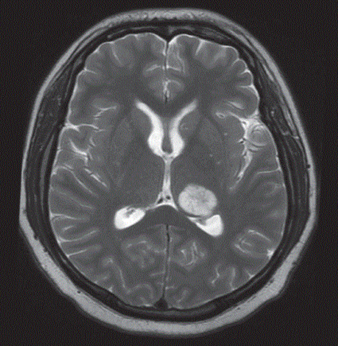
CNS cryptococcosis
Most common manifestation of cryptococcal disease.
CNS pathology include:-
Meningitis
Meningoencephalitis
Mass lesions
Symptoms are usually subacute or chronic in nature occurring over several weeks
Can be acute in severely immunocompromised patients with high fungal load
High CrAg titres
High intracranial pressures
C. gattii is more likely to cause obstructive hydrocephalus or parenchymal mass lesions unlike C. neoformans
High intracranial pressures and craniopathies as a result
Poor response to antifungals
Notes:
Right-Virchow robin space enlargement
Left- Ring enhancement

Slide 8
How do patients with CNS cryptococcosis present?
Features includes:
Headache
Fever /or normal temperature
Slow thinking or confusion
Cranial nerve palsies
Neck stiffness
Coma
Lethargy
Features includes:
Confusion
Nausea and vomiting (with increased intracranial pressure)
Obtundation
Blurred vision, photophobia, and diplopia
Hearing defects, seizures, ataxia, aphasia, and choreoathetoid movements

Slide 9
Clinical Manifestations at Diagnosis – AIDS in Zaire
96%
70%
51%
Patients (%)
23%
15%
11%
8%
Heyderman et al., Clin Infect Dis. 1998;26:284-9

Slide 10
Clinical Manifestations at Diagnosis - France
HIV +
HIV -
Patients (%)
Darras-Joly et al. Clin Infect Dis.1996;23:369-76
Dromer et al., PLoS Medicine. 2007;4(2):e21

Slide 11
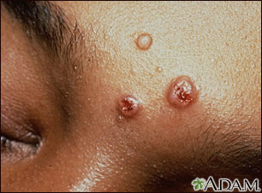
How else can cryptococcosis manifest?
Skin
Prostate
3rd most common site
in disseminated disease
Primary cutaneous cryptococcosis is very rare
Solitary skin lesion
Usually direct inoculation
Secondary lesions (disseminated disease)
Molluscum contagiosum-like lesion
Acneiform, purpura, vesicles, nodules, abscesses, ulcers
Serotype D strains
May be indistinguishable from other fungal (e.g. histoplasmosis) or viral skin lesions
Skin biopsy for culture and histopathology is a must for definitive diagnosis
Fairly common in AIDS
Usually asymptomatic
Nidus for relapse-a sanctuary site
Especially in patients with high tissue fungal burden
Urine or seminal fluid samples are required for diagnosis

Slide 12
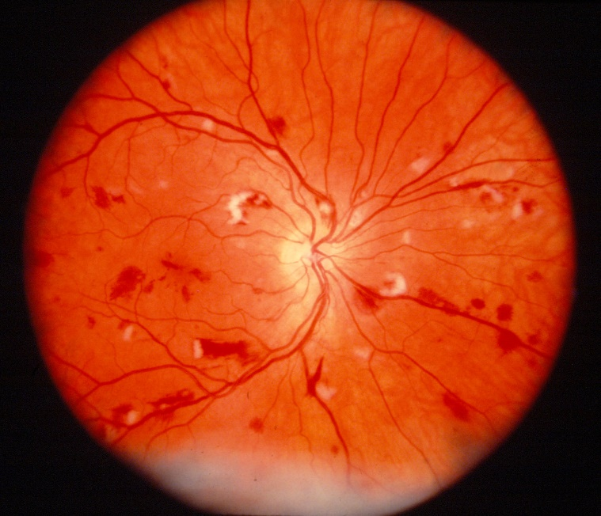
How else can cryptococcosis manifest?
Ocular manifestations
Ocular palsies
Papilledema
Vitritis
Visual loss
Chorioretinitis
Endophthalmitis
Pathogenesis
Optic nerve invasion
Rapid visual loss
Vascular compromise due to intracranial hypertension
Slow visual loss
Management of intracranial pressure prevents this
Any organ in the body can be affected in disseminated disease.
Osteomyelitis (disseminated disease)
Osteolytic lesions
Draining sinuses
Bone marrow infiltration
Peritonitis
Genitourinary tract infection
Adrenal involvement
Myositis
Hepatitis

Slide 13
Disseminated cryptococcosis - Summary
Cryptococcus affects most organ systems in the human host
The CNS, lungs and skin are the most common manifestations of cryptococcosis
Immune privileged sites, especially the prostate, is a potent nidus for relapse

Slide 14
End

