Slide 1
Pneumocystis & Mammals
Prof. David W. Denning, The University of Manchester
with thanks to Prof. Jacques Guillot, DVM, PhD, dipl. EVPC- France

Slide 2
Intended Learning Objectives
Be aware of the different species of the genus Pneumocystis and their host animals
To be familiar with the morphology, life cycle and transmission of Pneumocystis jirovecii
To understand when exposure occurs and the various risk factors for colonisation

Slide 3
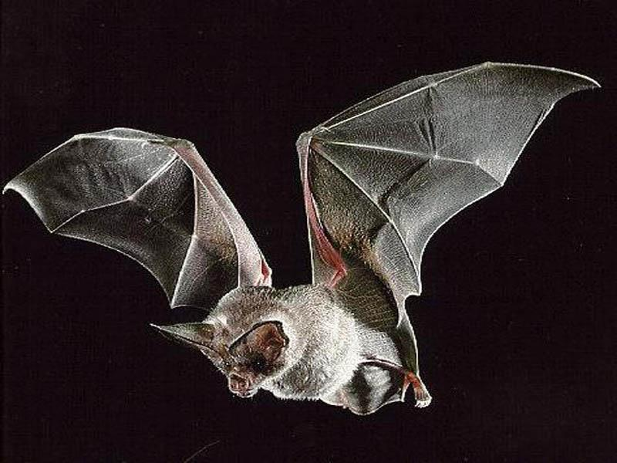
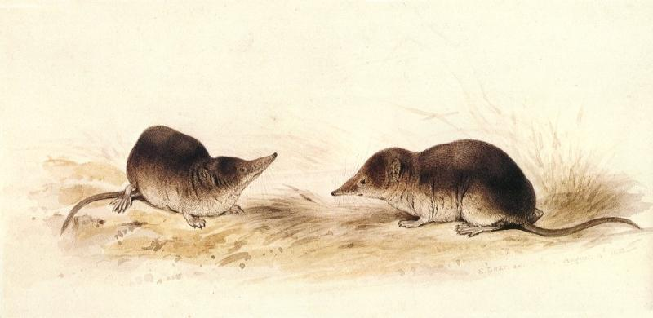
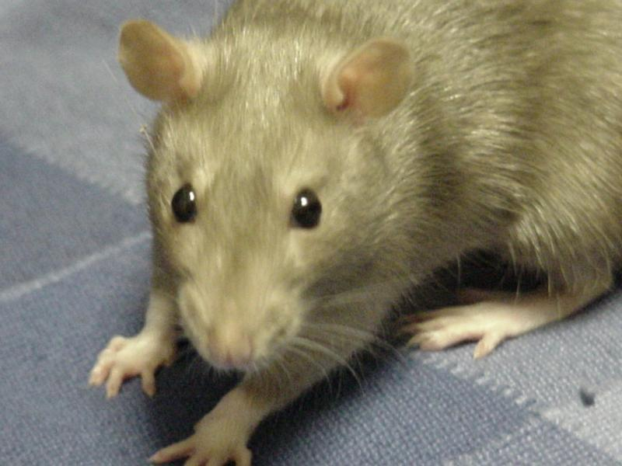
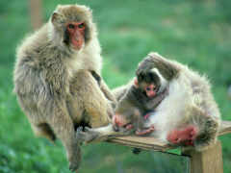
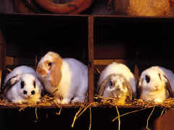
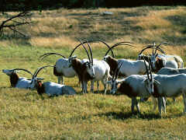
Groups of mammals where Pneumocystis organisms have been detected
bats
insectivores
rodents
marsupials
primates
carnivores
lagomorphs
mammals & dolphins
ungulates
Notes:
i) Host specific.
ii) Thought to be hundreds maybe thousands of species.
iii) Pneumocystis has been detected in different groups of mammals.

Slide 4
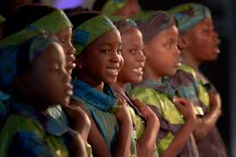
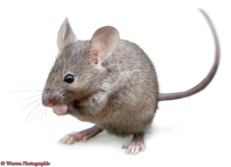
How many species in the genus Pneumocystis ?
Pneumocystis carinii
Pneumocystis wakefieldiae
Pneumocystis jirovecii
(Frenkel 1999)
Pneumocystis murina
Pneumocystis pneumonia = PcP
Pneumocystis oryctolagi
= a zoonotic disease
Pneumocystis sp
Notes:
i) 5 species named above have been formally described (as opposed to hundreds of others) according to the International Botanical Code of Nomenclature
P. Carinii & P. Wakefield- rats
P. murina- mice
P. Oryctolagi – rabbits
P. Jirovecii- humans
iii) Picture source- wikipedia african children’s choir.

Slide 5
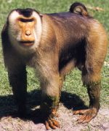
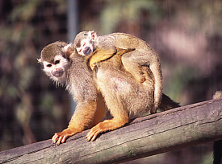
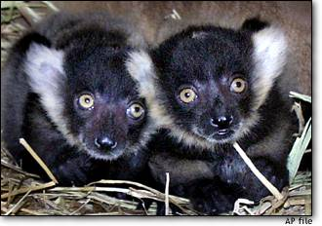
A fascinating process of co-speciation over millions of years
P. from human (P. jirovecii)
Old World
Primates
95
Pneumocystis
mtLSU sequences
P. from chimpanzee
58
70
P. from owl-faced guenon
100
P. from white-nosed guenon
P. from swamp guenon
95
100
P. from pig-tailed macaque
98
P. from cynomolgus macaque
91
P. from rhesus macaque China
P. from rhesus macaque India
P. from squirrel monkey
P. from saki
New World
Primates
80
100
P. from common marmoset
P. from Geoffroy’s marmoset
68
100
P. from Goedi’s tamarin
P. from Weddell’s tamarin
53
100
P. from red-handed tamarin
99
P. from emperor tamarin
P. from pinche
100
P. from hapalemur
Lemurs
P. from black lemur
100
P. from mouse (P. murina)
Rodents
P. from brown rat (P. carinii)
Demanche et al. J Clin Microbiol 2001:39:2126
Notes:
Co-speciation- 2 closely associated species evolve in response to and in concert with each other. In this case, as the host undergoes speciation, the Pneumocystis species also divide into genetically isolated populations.
mt LSU denotes mitochondrial Large subunit sequences-one of the markers used to identify species.

Slide 6
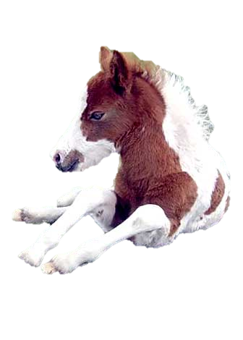
Animals for which Pneumocystis may have a clinical impact
Immuno-compromised young horses
Young rabbits
specific young dog breeds

Slide 7
Pneumocystis jirovecii
Fungus based on DNA sequence homology with fungal organisms as opposed to protozoa
Pneumocystis jirovecii - species that infects human lungs only and renamed in honor of Otto Jirovec
Belong to the Taphrinomycotina branch of the fungal kingdom together with Schizosaccharomyces pombe
Has not been routinely grown in cultures outside the human lungs and therefore transmission, life cycle and morphology still under further investigation

Slide 8
PCP lifecycle
Morphological forms - trophozoites and mature cysts
Trophozoites represent 90-95% of total population in host’s lungs
Trophozoites are vegetative ,amoeboid in shape, appear mononuclear (2-8 µm), mostly haploid eukaryotic cells and have a thin cell wall. Cytoplasmic projections help them attach to type I pneumocytes
Mature cysts contain eight individual spores which can be spherical, irregular or banana-shaped consist of a single nucleus, dense cytoplasm and a cell wall.

Slide 9
Morphology
Haploid trophozoites
Late sporocyte with 8 spores
Thomas C. et al Nature Reviews Microbiology 5 :298-308 (2007)

Slide 10
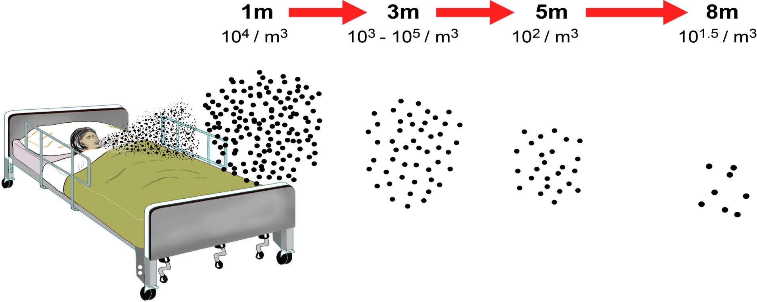
Transmission (1)
Host to host via the airborne route.
Choukri et al. J Medical Microbiol 2012;61:1009
Notes:
Results. Forty patients were diagnosed as having Pneumocystis pneumonia. Air sampling was performed in the
environment for 19 of them. At a 1-m distance from patients’ heads, P. jirovecii DNA was detected in 15 (79.8%)
of 19 patients, with fungal burdens ranging from 7.5103 to 4.5106 gene copies/m3. These levels decreased
with distance from the patients (P < 0.002). Nevertheless, 4 (33.3%) of the 12 samples taken at 8 m, in the corridor
adjacent to their room, were still positive. Forty control samples were collected and remained negative.

Slide 11
Transmission (2)
COPD patients, and those with chronic respiratory disease
HIV patients with low CD4 counts, especially with PCP
Immunocompromised patients, including malignancy
Pregnancy
Young children, especially with an upper respiratory tract infection
Auto-immune disease
Transplant recipients
Morris A & Norris KA. Clin Microbiol Rev 2012; 25: 297

Slide 12
Risk factors for colonisation
Recent exposure
to PCP
Lack of
PCP
prophylaxis
Low CD4
count
Geographic
location
lowlo
Smoking

Slide 13
Pathogenesis
Increased mucous production which may to lead to small airway closure in young infants
Up regulation of immune response mediated by alveolar macrophages, CD8+ & CD4 + T cells results in damage characterized by desquamation of alveolar lining with exudate formation
Increased permeability with capillary leakiness leads to pulmonary edema
Occasionally, lung destruction & formation of pneumatoceles occurs (especially in HIV infected have impaired immune response and low grade infection)

Slide 14
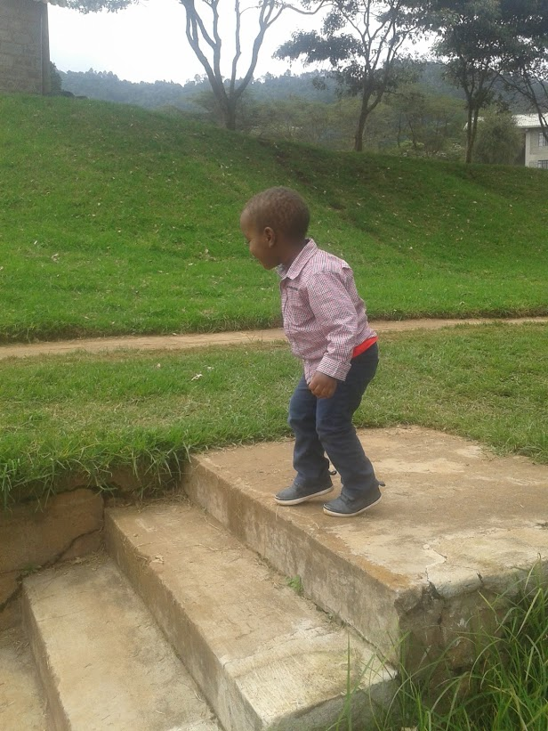
Epidemiology (1)
Primary infection occurs early in life and is the most prevalent microorganism identified in infant lungs to date
Serologic evidence of exposure by age 2 years is almost universal

Slide 15
Epidemiology (2)
Species are host specific hence no animal reservoir
Pneumonia results from de novo acquisition of fungus from exogenous source (likely other humans)
Cohorts of patients living together are often infected by similar strains
Reports of outbreaks

Slide 16
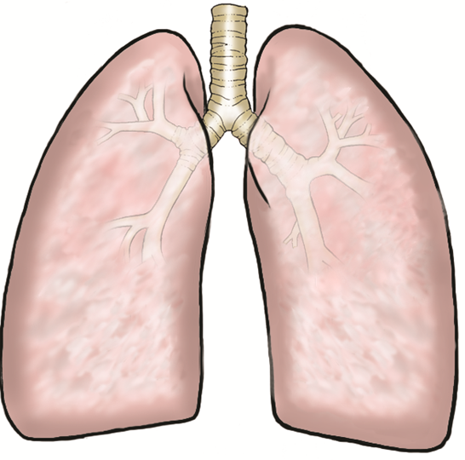
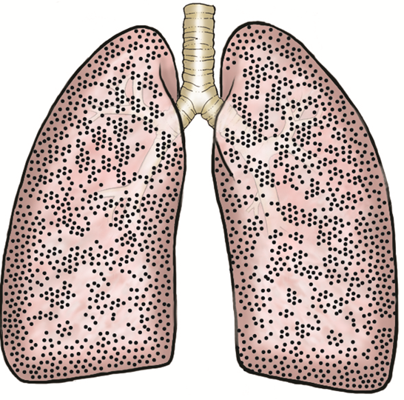
Primary infection
Asymptomatic
Mild URTI symptoms
CLEARANCE OF INFECTION
COLONISATION
Colonisation with low organism burden
Higher colonisation rates in children & immunosuppressed.
Notes:
i) Primary infection occurs shortly after birth and is either asymptomatic or leads to mild URI symptoms
ii) Antibodies formed in infancy & early childhood.
iii) Primary infection associated with SUIDs in one series.
iv) levels of colonization (between 14% and 25%) have been noted by other investigators in the immunocompetent pediatric population with acute respiratory syndromes like bronchiolitis or chronic lung diseases. Morris A, et al Epidemiology and clinical significance of Pneumocystis colonization. J Infect Dis 2008;197:10-7

Slide 17
SUMMARY
Pneumocystis jirovecii exposure is universal in humans and acquired early in life
Each Pneumocystis species is host specific
Transmission is airborne

Slide 18
END

