Slide 1
Quantification of cryptococcal antigen titres
Radha Rajasingham, MD
Assistant Professor of Medicine
Division of Infectious Diseases
University of Minnesota

Slide 2
Intended Learning Outcomes
To learn how to measure different CrAg titres and report them
To understand the diagnostic value of cryptococcal antigen titres
To understand the value of CrAg titres to monitor disease and/or therapy

Slide 3
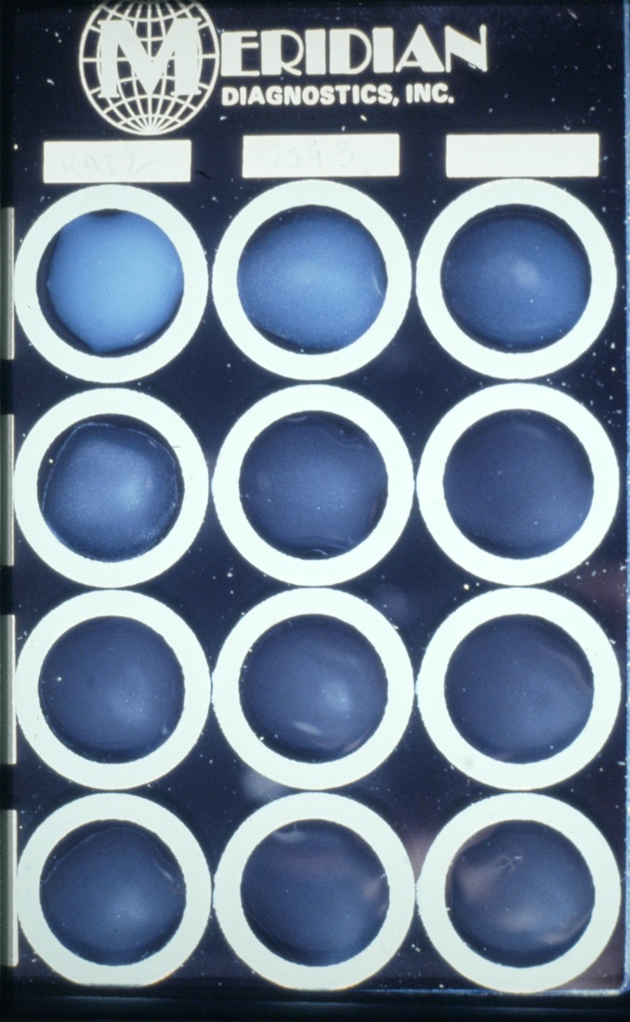
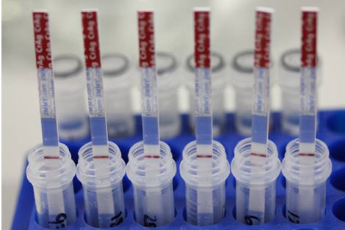
How to measure CrAg titres
2-fold dilution of CSF or serum using latex agglutination was the conventional method for measuring cryptococcal antigen titres.
But cryptococcal disease in AIDS yields very high titres and dilution is time-consuming and expensive
So alternative approaches are required and a clear diagnostic objective for the titre or determining prognosis

Slide 4
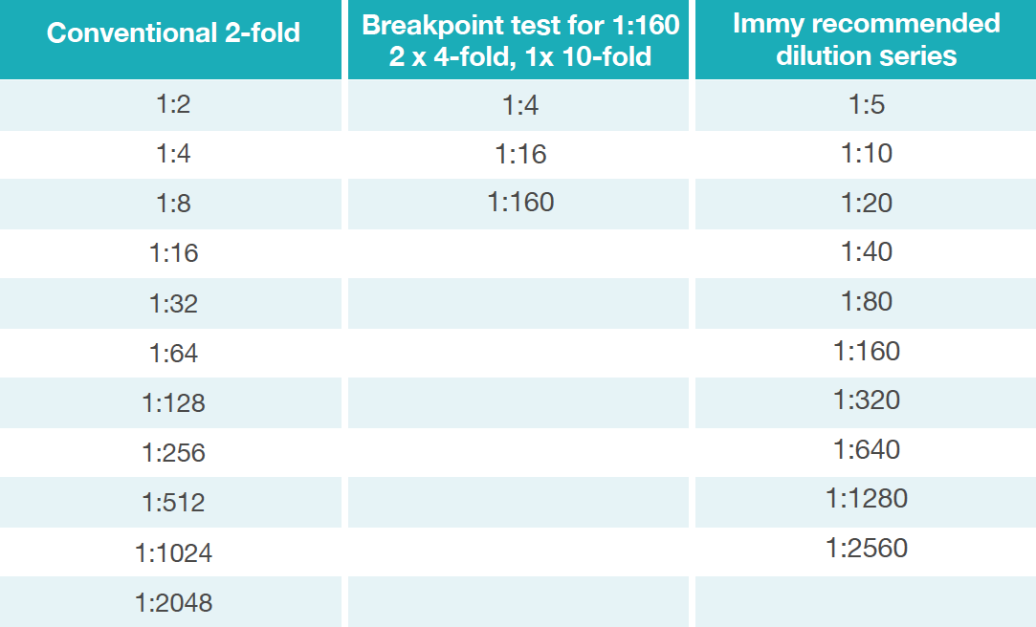
CrAg dilution series
www.gaffi.org/wp-content/uploads/GIFF3-Report-V15.pdf

Slide 5
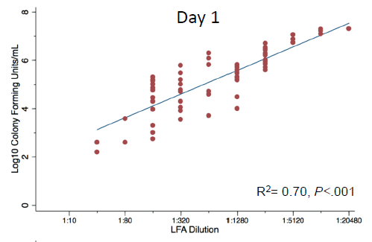
What is the diagnostic value of CrAg titres?
CrAg titre correlates with CSF cryptococcal culture
Kabanda et al. Clin Infect Dis. 2014.

Slide 6
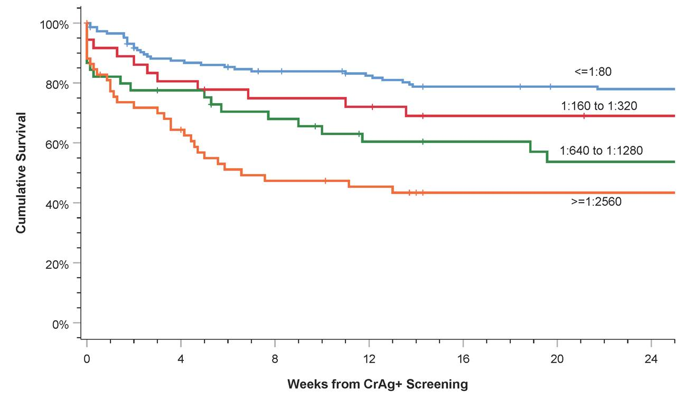
CrAg titre is associated with survival in HIV infection
Rajasingham R, Boulware DB. Clin Infect Dis. In press.

Slide 7
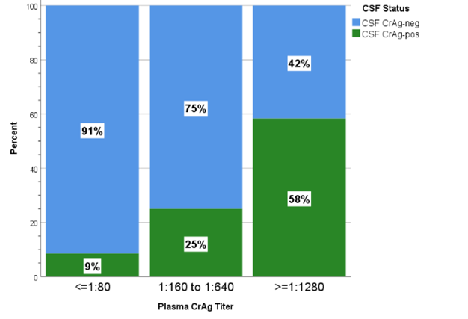
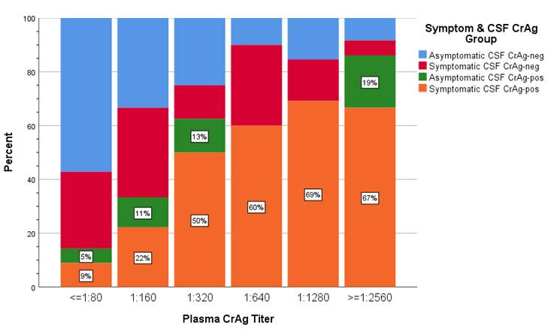
CrAg titres in asymptomatic cryptococcal infection
In asymptomatic HIV+, as CrAg titre increases in the blood:
CSF is more likely to be positive
Symptomatic CSF CrAg positivity (i.e., meningitis) increases
Serum CrAg titre >1:160 is predictive of meningitis
Sensitivity: 88%
Specificity: 82%
CSF CrAg+ among asymptomatic CrAg+
CSF CrAg+ among all CrAg+ screened
Rajasingham R, Boulware DB. Clin Infect Dis. 2019 In press. Wake RM et al. Clin Infect Dis 2018;66:686

Slide 8
Pulmonary cryptococcosis in transplant recipients
83% (40/48) of solid organ transplant recipients with pulmonary cryptococcal disease had a positive CrAg in serum
CrAg positivity associated with extrapulmonary disease – 19/40 (48%) compared those with negative CrAg - 1/8 (13%)
CrAg titre higher in those with cryptococcal fungaemia (1:512 vs 1:32)
CrAg less likely to be positive in patients with a single nodule (25%) compared to those with multiple nodules (88%)
Mortality not related to CrAg positivity or titre
Singh N et al. Clin Infect Dis 2008;46:e12.

Slide 9
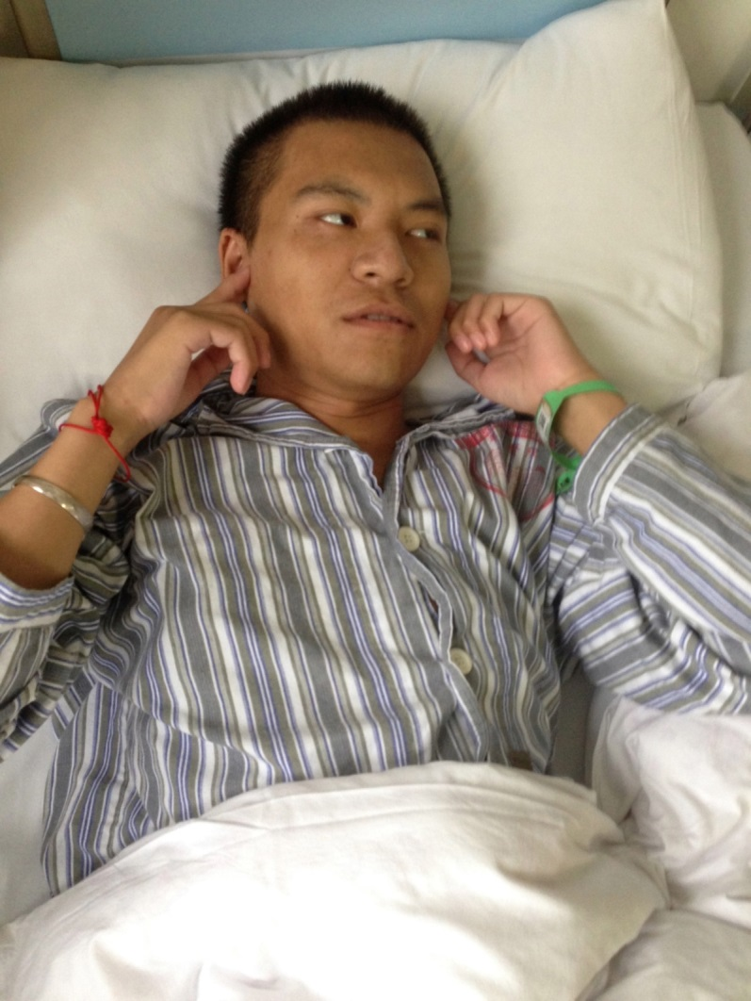
CrAg titre in HIV uninfected persons
CSF CrAg titres >1:256 at baseline were associated with:
Hearing loss in non-HIV cryptococcal meningitis
Neurological sequelae and death in those with C. gattii meningitis
CSF CrAg >1:512 associated with death or relapse at 1 year
Liao CH et al J Microbiol Immunol Infect 2012; 45:296
Chen SC et al Clin Infect Dis 2012;55:789
Wang HC et al. Neurol 2005;65:320.

Slide 10
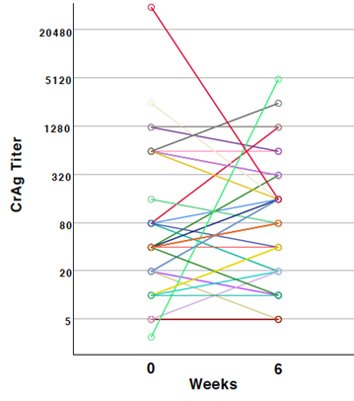
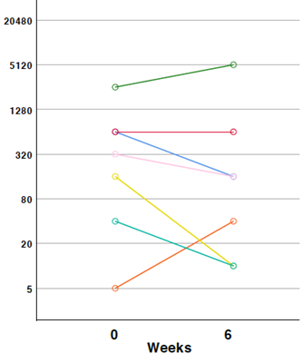
Clinical utility in monitoring CrAg titre
Follow up monitoring of CrAg titre is not useful in HIV-infected persons with cryptococcal meningitis
No difference in those with clinical response to treatment vs. persistent disease or relapse
In HIV-infected persons with asymptomatic CrAg positive persons, change in serum/plasma CrAg titre is not associated with survival
Survived
Died
Pullen MF et al. Clin Infect Dis. 2019 May 22.
Aberg JA et al. HIV Clin Trials. 2000.

Slide 11
Summary
Any positive CrAg in serum or CSF is associated with disease and needs evaluation and treatment
High titres in serum at baseline are associated with meningitis, neurological sequelae, and death in HIV+ and HIV- cohorts
In HIV-infected persons with asymptomatic cryptococcal infection, high titres in blood are predictive of subclinical cryptococcal meningitis and death
The best cut-off for predicting meningitis in HIV-infected persons is >1:160
There is no value in monitoring CrAg titres over time in HIV-infected persons with cryptococcal meningitis, or asymptomatic cryptococcal infection

Slide 12
End

