Slide 1
Histoplasmosis in Children
Flavio de Queiroz Telles, MD, PhD
Associate Professor
Department of Public Health
Hospital de Clínicas, Universidade Federal do Paraná

Slide 2
Intended Learning Outcomes
Global distribution of Histoplasma and other endemic mycoses
Clinical presentations in children of different ages
Underlying immune conditions
Differential diagnosis and the role of histopathology

Slide 3
Patterns of histoplasmosis in children
Asymptomatic
Acute pulmonary histoplasmosis (related to significant exposure)
Neonatal histoplasmosis – acute and subacute
Subacute or chronic histoplasmosis in older children
Disseminated histoplasmosis in immunocompromised children
Remember to take a travel and exposure history

Slide 4
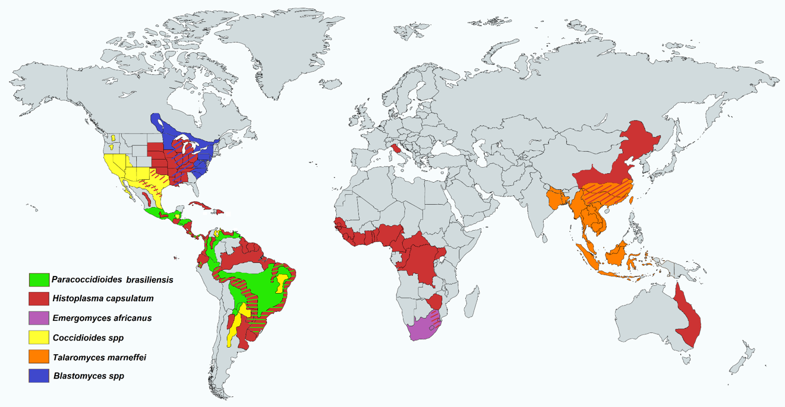
Global Distribution of the Endemic Systemic Mycoses
Paracoccidioides brasiliensis
Emergomyces africanus
Talaromyces marneffei
Histoplasma capsulatum
Coccidioides spp.
Blastomyces spp.
www.cdc.gov

Slide 5
Global distribution of Histoplasma capsulatum
Traditional histoplasmosis regions:
H. capsulatum var. capsulatum – worldwide
Eastern U.S. Ohio, Mississippi, St. Lawrence River valleys
Most of Latin America, especially central America and Guyana Shield
H. capsulatum var. duboisii – sub-Saharan Africa (Western/Central)
India:
Skin-test positivity rate of 12.3% in northern India (1950s-1970s)
H. capsulatum was isolated from soil on the Gangetic plains
China:
Histoplasmin survey – 1006 healthy individuals or patients with lung diseases Prevalence: 6%-35%, according to the province
Proven disease – From 300 histo cases, 75% were considered autochthonous, most (82%) from the Yangtze river valley
Autochthonous cases from African countries, Thailand, Myanmar, Philippines, Indonesia, Australia
Antinori S. J Trop Med Hyg 2014; 90:982-983.

Slide 6
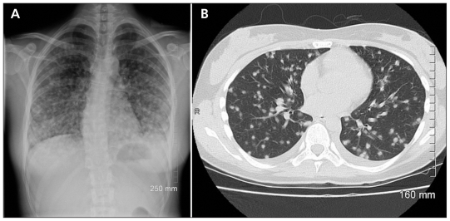
Acute pulmonary histoplasmosis
Acute pulmonary Histoplasmosis (APH)
~90% of patients develop sub-clinical, self-limiting pulmonary infections following inhalation of microconidia
Risk factors for APH
High-inoculum exposure
Age: <2 or >50 years
Immunocompromised individuals
Virulent strains
Symptoms (Onset 1-2 weeks)
Fever, chills, dyspnoea, and cough
Arthralgia, arthritis and erythema nodosum
Chest imaging
Enlarged hilar/mediastinal lymph nodes
Diffuse bilateral patchy opacities
Complications
Acute respiratory distress syndrome
Disseminated disease (Histoplasmosis)
Both images show symmetrically distributed nodules consistent with acute histoplasmosis
Dylewski J. CMAJ 2011; 183: e1090
Notes:
Acute pulmonary histoplasmosis is not easily distinguishable from community-acquired viral or bacterial pneumonia

Slide 7
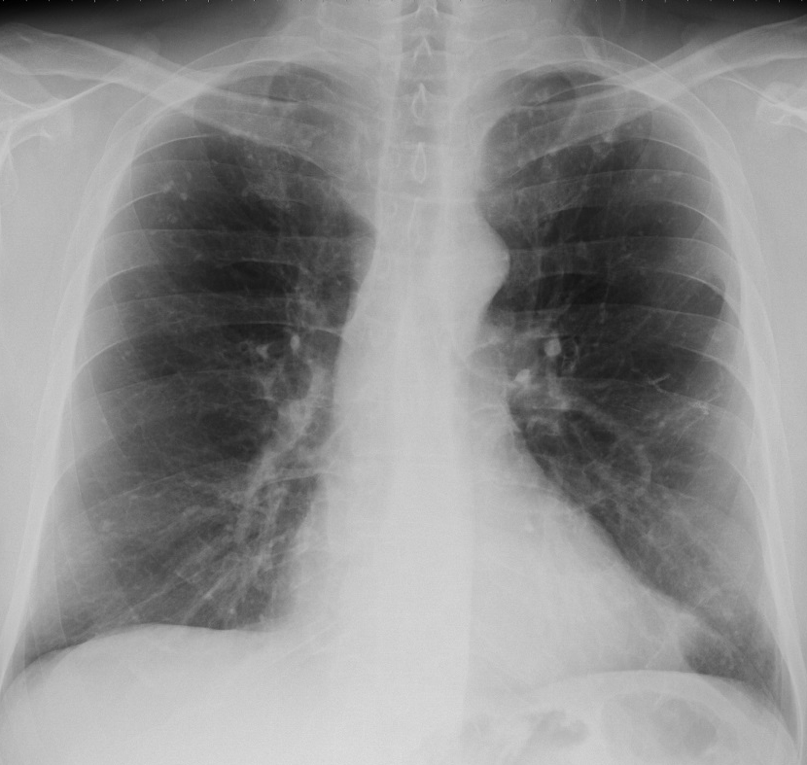
Acute pulmonary histoplasmosis 2
Acute pulmonary histoplasmosis
Fever and headache 100%
Chills, cough, chest pain 67%
Non-specific signs
Erythema nodosum/multiforme
Hepatosplenomegaly
Pyrexia
Mild <38.5C 1-5 days
Moderate 39.5C 5-7 days Severe 40+ C 9-18 days
Mediastinal calcifications following histoplasmosis
Chest X-ray normal in 75%
Notes:
7

Slide 8
Case Presentation
4 y/o girl presented with a 06 mo. history of an ulcerated lesion on the face
She lived with her family in small farm. Contact with domestic animals: chicken, cows, pigs
Initial clinical diagnosis = mucosal leishmaniasis
Proved histoplasmosis was documented by histology and culture
She was successfully treated with itraconazole
Died at the age of 13 yrs from pneumonia related to autosomal dominant Hyper – IgE Syndrome (HIES)

Slide 9
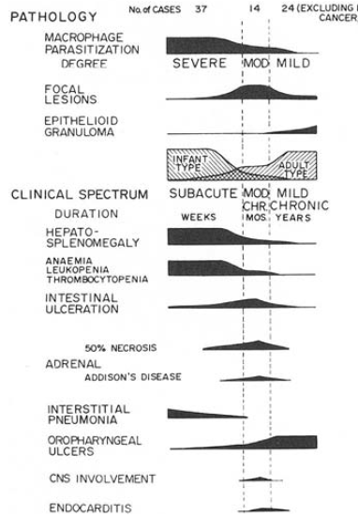
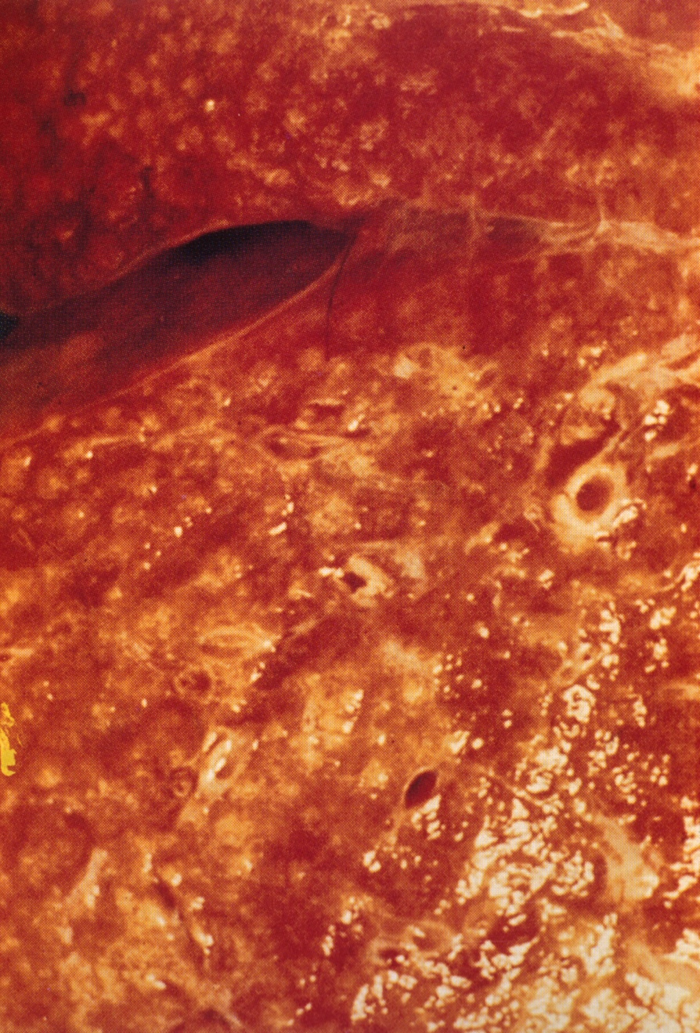
Neonatal histoplasmosis
Macroscopic appearance of liver at autopsy with ‘miliary appearance’ in a baby
Goodwin RA, Des Prez RM. Am Rev Resp Dis 1978;117:929

Slide 10
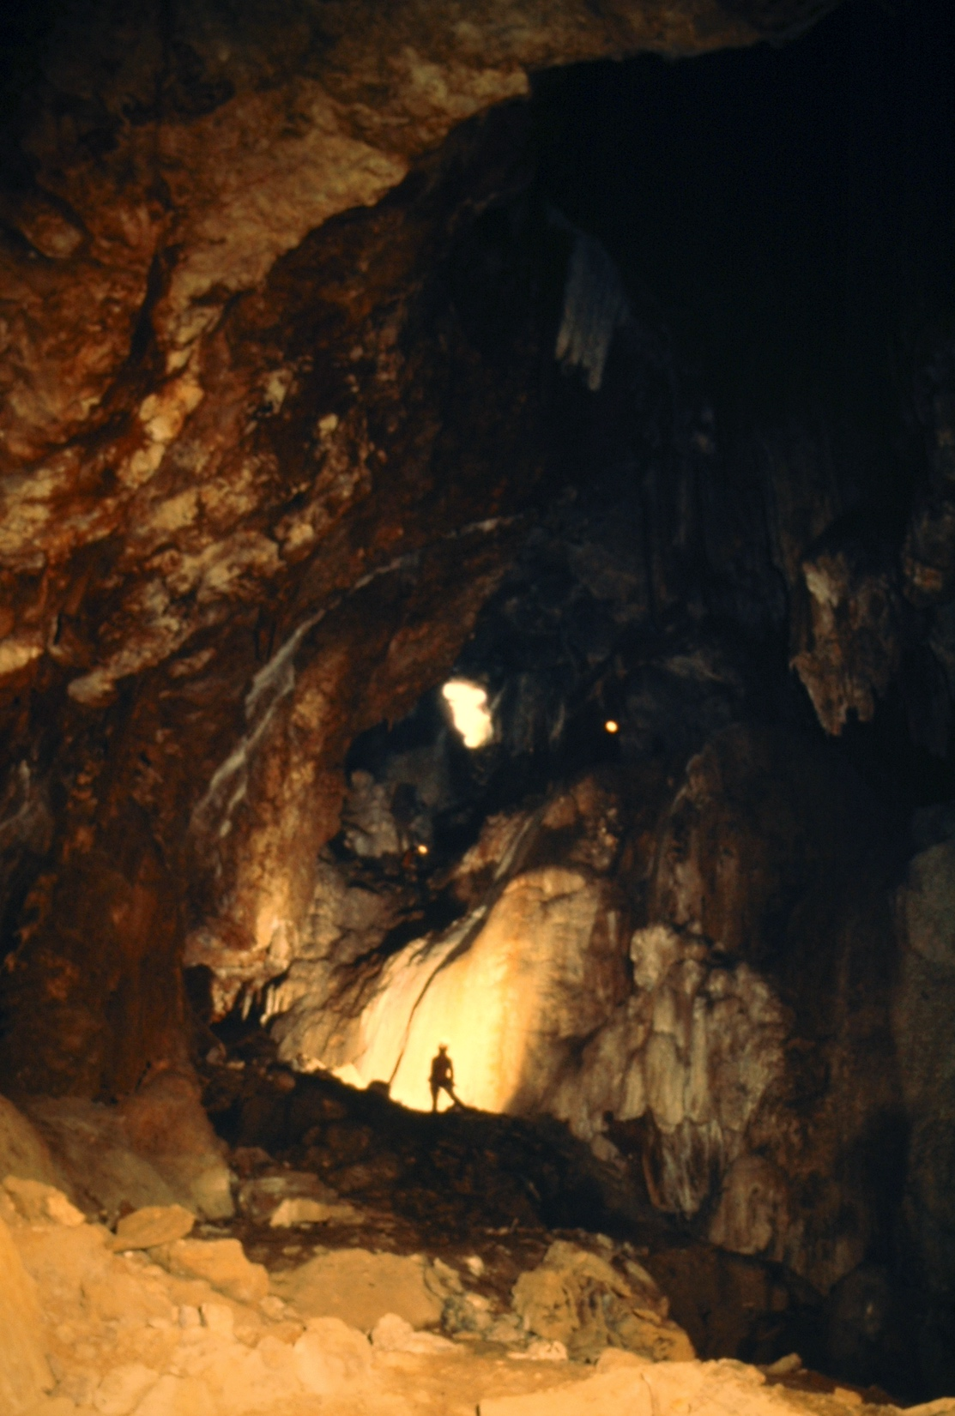
Clinical manifestations of histoplasmosis
Depends on both pathogen and host factors
FUNGAL: inoculum size; strain virulence
HOST: extremes of age (i.e. infants); malnutrition; conditions causing immunodeficiency (e.g. AIDS, malignancies); transplants (e.g. HSCT, solid organs); medications causing immunodeficiency (e.g. anti-TNF, steroids)
Most infections are asymptomatic
Most of the published data on paediatric histoplasmosis are from outbreaks and case reports
Bat cave

Slide 11
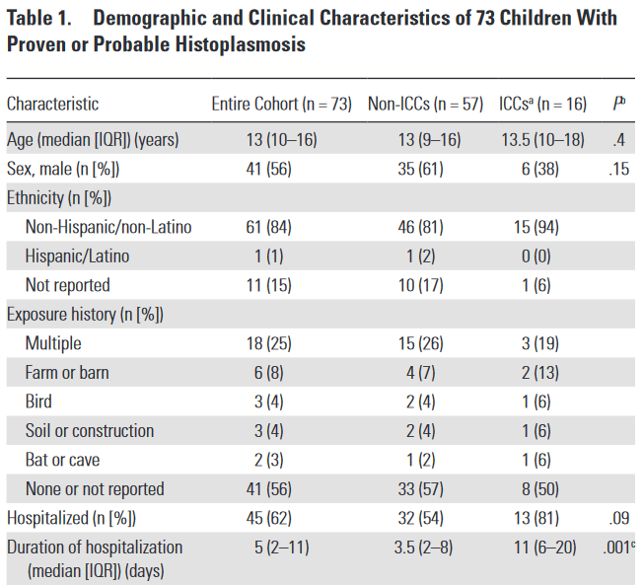
Paediatric histoplasmosis in an endemic area: Demographics
Ouelette et al, 2018
Retrospective cohort study in Ohio, USA (N = 73)
3-18 y/o immunocompromised children with proven (n=13) or probable (n=56) histoplasmosis
22% were immunocompromised
ICC = immunocompromised children
Ouellette et al. JPIDS 2018;6:996

Slide 12
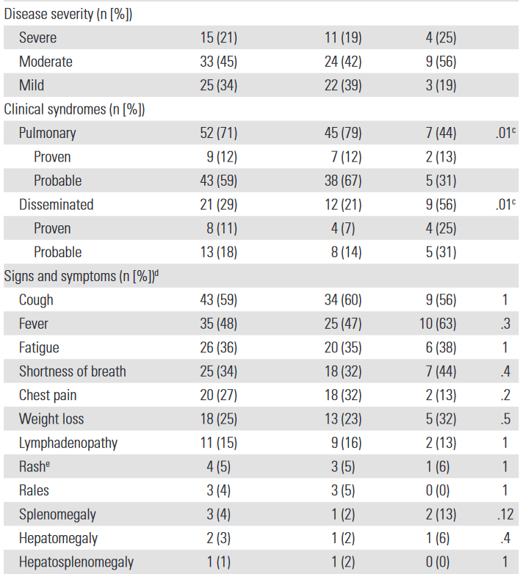
Paediatric histoplasmosis in an endemic area: Clinical characteristics
Site of infection
71% unifocal/pulmonary infections
21% disseminated infections
Underlying conditions
56% of ICCs received anti-TNFs
31% of ICCs had a malignancy
No HIV/AIDS patients
Treatment
67% received antifungal therapy (itraconazole or liposomal AmB)
Ouellette et al. JPIDS 2018;6:996

Slide 13
Chest X-rays and histopathology
Stain: methenamine silver

Slide 14
Diagnosis of paediatric histoplasmosis in an endemic area
Immunocompromised children (ICC) had a higher titre of Histoplasma antigen in both serum and urine, and were significantly more likely to test positive
Blood antigen | Entire cohort N = 48 | Non-ICCs n = 35 | ICCs n = 13
% positive | 42% | 31% | 69%
Median concentration (ng/ml) | 1.3 (0.5-7.4) | 0.66 (0.5-1.5) | 7.5 (1.3-15.7)
Urine antigen | Entire cohort N = 53 | Non-ICCs n = 40 | ICCs n = 13
% positive | 28% | 18% | 62%
Median concentration (ng/ml) | 5.4 (3.8-6.5) | 4.5 (0.6-5.4) | 6.4 (4.3-10.7)
Remember that Histoplasma antigen is a galactomannan and reacts with Aspergillus GM test
Ouellette et al. JPIDS 2018;6:996

Slide 15
Include histoplasmosis in the differential diagnosis of:
Fever of unknown origin in AIDS and transplant patients
Chronic diarrhoea and intestinal bleeding
Acute and chronic pulmonary infection
Cellulitis and other skin lesions
Febrile hepatosplenomegaly
Febrile wasting syndrome
Chronic endocarditis
Chronic oral ulcers
Chronic meningitis
Addison disease
Kauffman et al Clin Chest Med 2009;30:217-25; Agudelo et al Am J Trop Med Hyg 2012;87:1094-8;
Ozdalga et al J Gen Intern Med 2012;27:1219; Yang et al BMC Infect Dis 2013;13:143;
Severo et al Rev Inst Med Trop Sao Paulo, 2001;43: 183-7; Assi et al Medicine 2007;87:162-9.

Slide 16
10 clinical syndromes where histoplasmosis should be part of the differential diagnosis
Acute and chronic pulmonary infection
Febrile wasting syndrome
Febrile hepatosplenomegaly
Fever of unknown origin in AIDS and SOT recipients
Chronic meningitis
Addison disease
Chronic oral ulcers
Chronic diarrhoea and intestinal bleeding
Chronic endocarditis
Cellulitis and other skin lesions
Kauffman et al Clin Chest Med 2009;30:217-25; Agudelo et al Am J Trop Med Hyg 2012;87:1094-8;
Ozdalga et al J Gen Intern Med 2012;27:1219; Yang et al BMC Infect Dis 2013;13:143;
Severo et al Rev Inst Med Trop Sao Paulo, 2001;43: 183-7; Assi et al Medicine 2007;87:162-9.

Slide 17
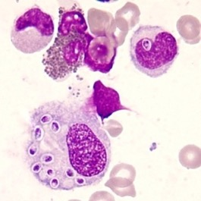
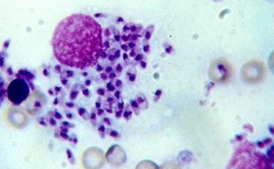
Differential microscopic diagnosis
Histoplasma must be distinguished from other intracellular fungi (e.g. Candida, Pneumocystis) and protozoan parasites (e.g. Trypanosoma, Leishmania, Toxoplasma)
Histoplasma capsulatum
Other intracellular pathogens
RBC
WBC nucleus
Pathogen
Stain: Giemsa
*
*
*
Small (2−5µm) yeast cells
Intracellular
Pale ‘halo’
Leishmania amastigotes
Trypanosoma trypomastigote
Toxoplasma gondii
* images from CDC

Slide 18
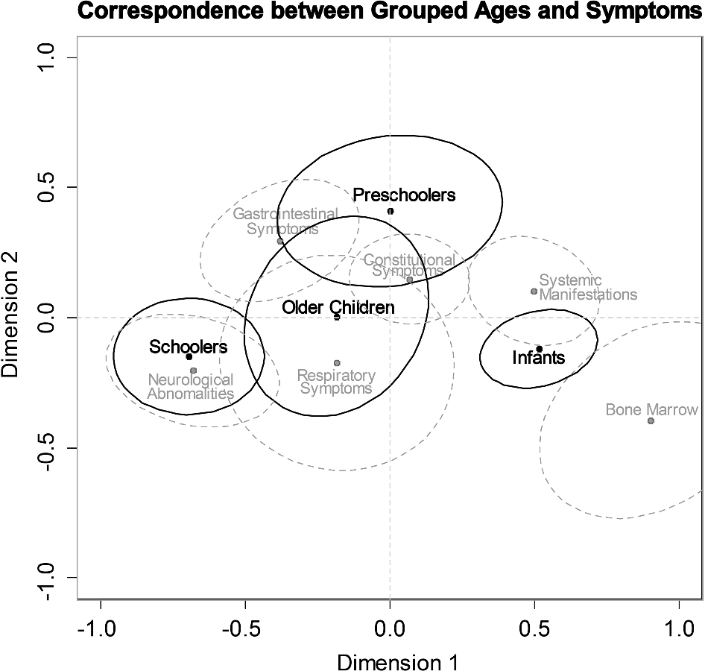
Correlation between age and clinical symptoms
Lopez et al, 2016
Retrospective study
Colombia 1984-2010
45 paediatric patients
Malnutrition: 37%
Environmental exposure: 33%
AIDS: 15%
Infants: systemic
Preschool: GI/constitutional
School-age: neurological
Older: GI/respiratory/constitutional
Lopez et al Med Mycol 2016;54:677-83

Slide 19
Prevention – minimising exposures
Reconsider visiting caves or any other areas with high concentrations of bird or bat droppings
Bamboo groves or upright structures with birds roosting are a risk
Keeping backyard chickens or racing pigeons may be risky activities in endemic areas
Beware empty buildings (because they often end up as nesting sites for birds), chicken coops, farms, stream banks, golf courses, some amusement parks and tennis complexes in endemic areas (not always realistic)
Families should use personal protective equipment, including gloves, protective clothing, and respirators, or high quality masks.
Diaz J. Wilderness & Environ Med 2018;29:531

Slide 20
Summary
Most infections are asymptomatic
Disseminated histoplasmosis is associated with underlying immune conditions such as AIDS, although may be seen in infancy due to immaturity of the immune system
Most paediatric data and treatment guidelines are extrapolated from adult patients – but children are not small adults!

Slide 21
End

