Slide 1
Treatment of histoplasmosis
Professor David W. Denning
The University of Manchester

Slide 2
Intended Learning Outcomes
To be aware of the treatment goals for histoplasmosis
To be aware of manifestations that usually require treatment and those that do not
To be aware of treatment outcomes in histoplasmosis

Slide 3
Overview
Antifungal treatment is always recommended for immunocompromised patients with histoplasmosis
Acute histoplasmosis resolves without treatment in most immunocompetent healthy individuals, in whom treatment is usually not recommended
BUT if immunocompetent patients are exposure to large inoculum of Histoplasma spp. and are highly symptomatic, antifungal treatment is advised
Early initiation of treatment is associated with shortened duration of illness and halts progression to persistent disseminated histoplasmosis and save lives in very ill patients

Slide 4
Which manifestations to treat
USUALLY or ALWAYS treated
Usually NOT treated
Acute pulmonary histoplasmosis (sometimes)
Chronic pulmonary histoplasmosis (always)
Progressive (Acute) disseminated histoplasmosis (always)
Chronic disseminated (adrenal, colonic, oropharyngeal etc) (always)
Acute pulmonary histoplasmosis (usually)
Pulmonary nodules
Mediastinal histoplasmosis
  Lymphadenopathy
  Adenitis
  Fibrosis
Presumed ocular histoplasmosis
Wheat et al. Infect Dis Clin N Am. 2016;30:207-227

Slide 5
Acute pulmonary histoplasmosis
Treat
Don’t treat
Moderate-severe disease
Diffuse bilateral infiltrates on chest imaging
Immunosuppression
Treatment options:
Amphotericin B for 1-2 weeks followed by itraconazole for 12 weeks
Itraconazole alone for 12 weeks in mild to moderate disease
Asymptomatic patient
Mild disease
Focal infiltrates on chest imaging
Rationale:
  Mild acute pulmonary histoplasmosis is self-limiting
Wheat et al. Infect Dis Clin N Am. 2016;30:207-227

Slide 6
Progressive (acute) disseminated histoplasmosis
Treatment goals
  Early and effective antifungal therapy
  Control of underlying immunodeficiency
Hospitalised patients
  Liposomal amphotericin B for 2 weeks
  Then itraconazole for at least 1 year
  Check drug interactions
Milder cases or in non-severely immunocompromised patients
  Itraconazole for 12 months
Note
  Liposomal AmB has a better response rate and lower mortality than conventional AmB
  Alternatives to itraconazole includes voriconazole, posaconazole and isavuconazole
  Beware adrenal insufficiency
Treatment should be continued for at least 12 months and until antigenaemia and antigenuria have resolved
Adjunctive interferon gamma is recommended in patients with IL-12 and IFN-ɣ deficiency
Plasmapheresis / rituximab for adult immunodeficiency syndrome
Hage et al. Semin Respir Crit Care Med. 2015;36:729–745.
Vinh DC. Lancet Infect Dis. 2011;11:780-92

Slide 7
Chronic disseminated histoplasmosis
Benefits of antifungal treatment
Treatment options
Resolution of gastrointestinal lesions
Possibility of adrenal dysfunction recovery
Probably improved survival in those with adrenal masses and dysfunction
Avoidance of later complications (i.e. gut stricture or dissemination if immunocompromised)
Itraconazole 200-400mg daily for 6-12 months, unless already given empirical rifampicin for adrenal tuberculosis
Amphotericin B (preferably liposomal), if pretreated with rifampicin or other major drug interaction
Precautions
Pro-actively address adrenal dysfunction to avoid cortisol deficiency and ‘Addisonian crisis’
Ensure itraconazole levels are therapeutic

Slide 8
Chronic pulmonary histoplasmosis
Benefits of antifungal treatment
Treatment options
Induction of clinical and radiological remission
Culture conversion
Improved survival
Itraconazole for 12-24 months
Precautions
Ensure itraconazole levels are therapeutic
Chest imaging follow-ups: 4- or 6-monthly
Relapse is common following treatment ~15%
Watch for primary lung cancer during or after treatment
Wheat et al. Infect Dis Clin N Am. 2016;30:207-227

Slide 9
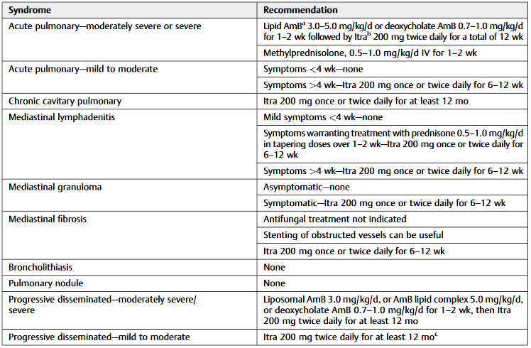
Treatment for common histoplasmosis syndromes
Adapted from Hage et al. Semin Respir Crit Care Med. 2015;36:729–745.

Slide 10
Treatment outcomes
Response to therapy
  60-80%
  Relapse occur in ~50% of responders
Life-long therapy is recommended for patients with relapse
Mortality
  100% if untreated
  CNS disease, ~80% (<5% with early diagnosis and early appropriate treatment)
  HIV and disseminated, ~20-40%
  Other manifestations, 0-10%
Factors responsible for worsening for symptoms includes
  Treatment failure
  IRIS
  Non-histoplasmosis related events
Suspect IRIS if worsening of symptoms despite:-
  Good adherence to antifungals
  Therapeutic antifungal levels
  Declining antigenaemia/antigenuria
  Negative cultures for Histoplasma
Wheat et al. Infect Dis Clin N Am. 2016;30:207-227
Haynes et al. J Infect Dis. 2002;185:223-8

Slide 11
Summary
Itraconazole is the first line of therapy for the treatment of histoplasmosis
Liposomal amphotericin B (preferable to deoxycholate ) is recommended for initial management of hospitalised patients and is associated with improved outcome
Be alert to and check for adrenal insufficiency, especially if rifampicin has been given
Treatment of disseminated disease should continue for at least 12 months and until antigenaemia and antigenuria have resolved
Alternative triazoles (voriconazole, posaconazole and isavuconazole) can be used for salvage therapy

Slide 12
References

Slide 13
Thanks for watching

